Slide 1
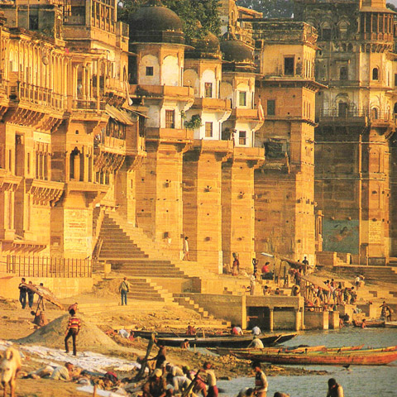
Focus: How did the Vedic tradition transform Indian culture?
Do now: Open up today’s PPT and begin working on the startup activity on the following slide.
Announcements: Complete homework reading and questions found at the end of today’s slideshow by tomorrow.

Slide 2
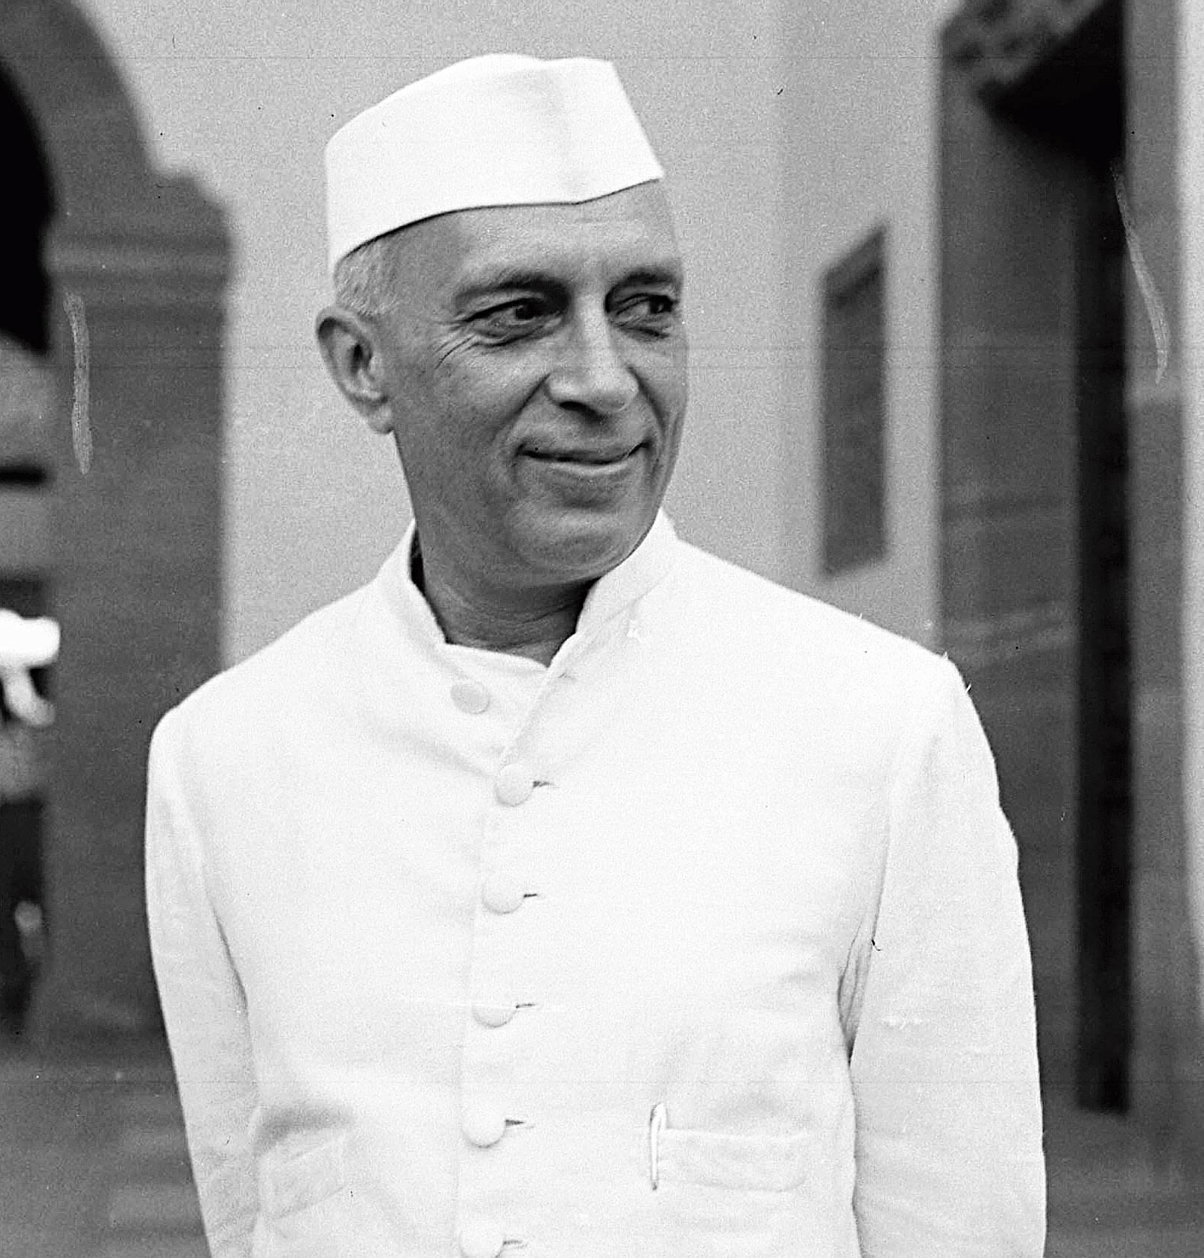
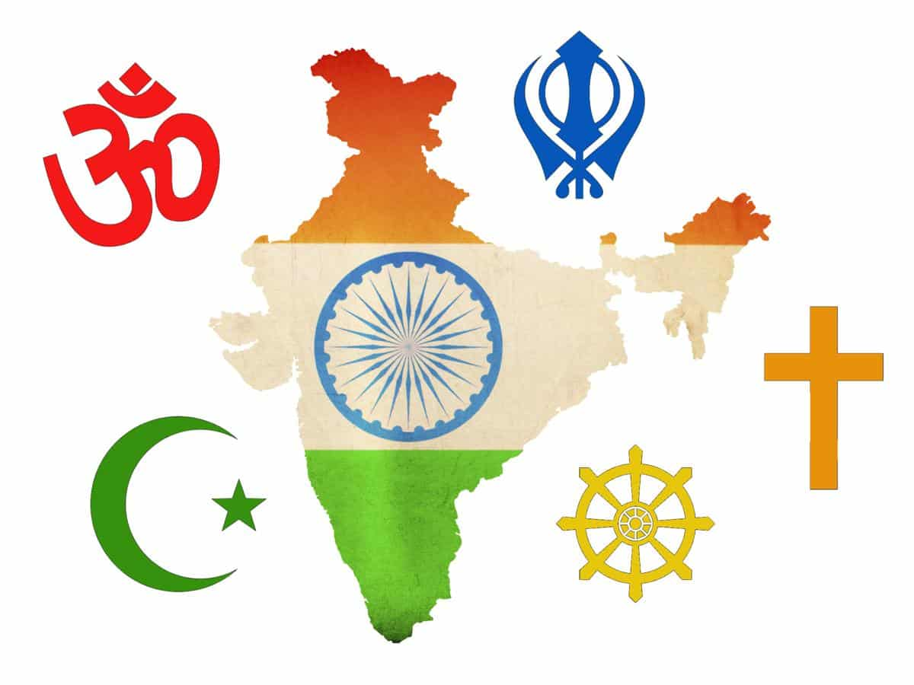
Pair/ Share: “The genius of India consists of synthesis”- Jawaharlal Nehru (first Prime Minister of India and a central figure in Indian politics before and after independence in the 20th century)
Focus: How did the Vedic tradition transform Indian culture?
How Does India’s early history reconfirm this view? Use the image to the right to support your response.

Slide 3
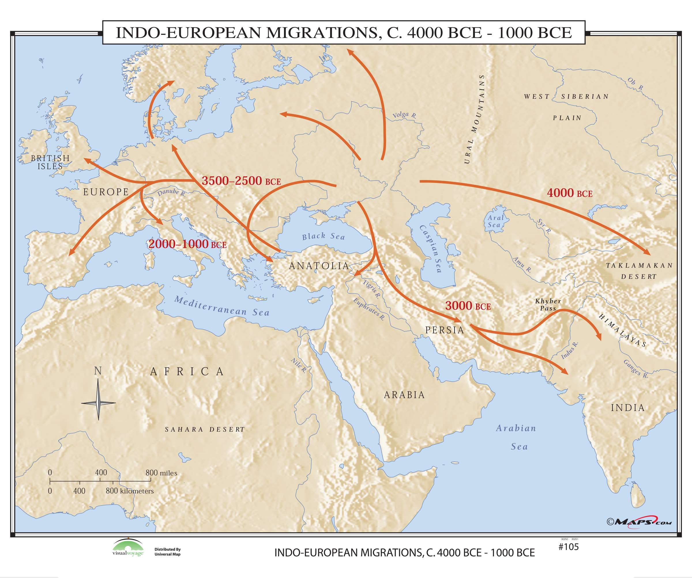

Slide 4
Focus: How did the Vedic tradition transform Indian culture?
Aryans-noble people (Indo-Europeans from the north)
The Aryans invaded the Indus River Valley in India around 1500 B.C. bringing their religious beliefs.
Hinduism/Vedic belief is a religion largely based on the beliefs of the Aryans.
Dravidians-native people of the subcontinent.
Vedic Age - Formation of the caste system – 1500 B.C.E.-500 B.C.E. – dominated by Aryans.
←---------1000 B.C.E.----------200 B.C.E.----------→
Aryan and Dravidian cultures blended together over hundreds of years to create Hinduism.
Syncretism - the amalgamation or attempted amalgamation of different religions, cultures, or schools of thought.

Slide 5
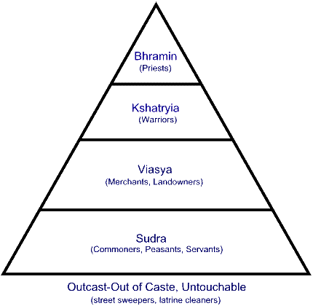
Caste System Each step represents a Varna
Focus: How did the Vedic tradition transform Indian culture?
Hierarchy – an organizational structure where there are people at the top and people in inferior positions.
Each caste has a jati – additional breakdown
Untouchables/Dalits- Lowest class, performed work with the dead.
“There is no water for you. This drought is your fault. The gods are angry at you for your past sins of selfishness, untruthfulness, and greed. Leave our well at once. Your presence will pollute what water we have.”
How were untouchables treated? Why were they treated this way?

Slide 6
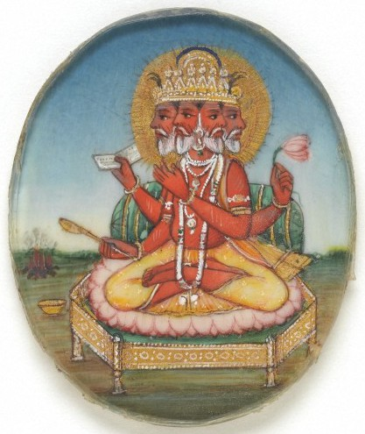
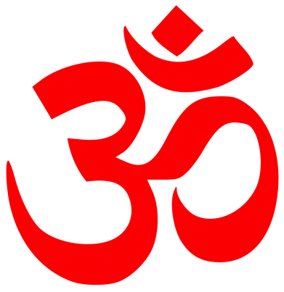
Brahma ( The Creator)
Focus: How did the Vedic tradition transform Indian culture?
Hinduism is the world’s 3rd most popular religion. This is the Hindu symbol for Om. It
represents the divine.

Slide 7
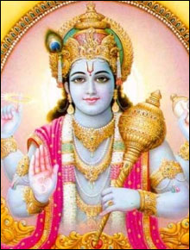
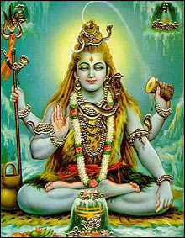
Vishnu (preserver/sustainer of life)
Shiva (The destroyer)
Read the following poem from the Rig Veda:
“When the gods divided the Man,
into how many parts did they divide him?
What was his mouth, what were his arms,
what were his thighs and his feet called?
The Brahman was his mouth, of his
arms was made the warrior.
His thighs became the Vaisya,
of his feet the Sudra was born”.
Pair/Share: Given this poem, what attitudes are shown about the different castes. Why would the castes be tied to those particular parts of the body?

Slide 8
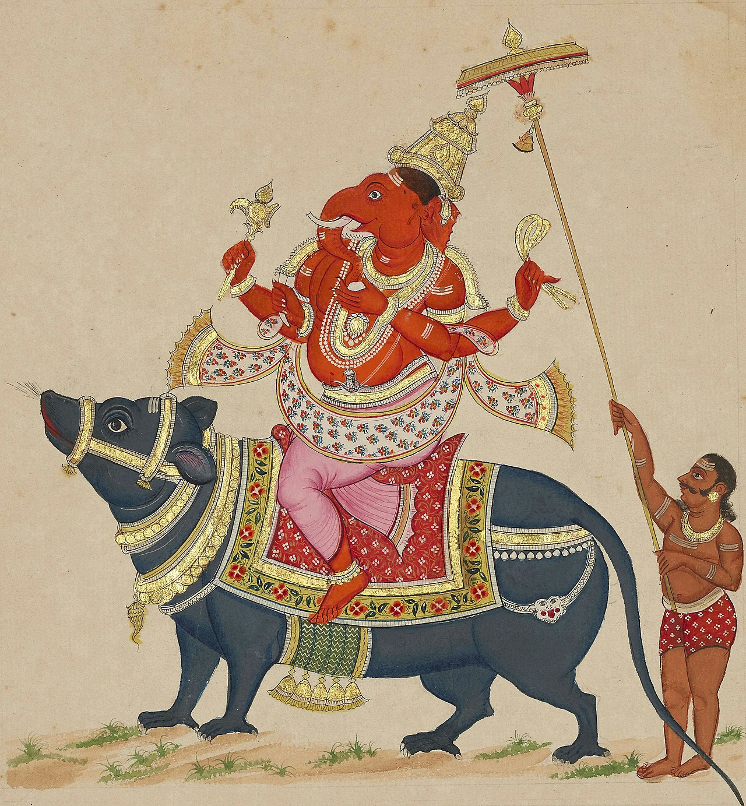
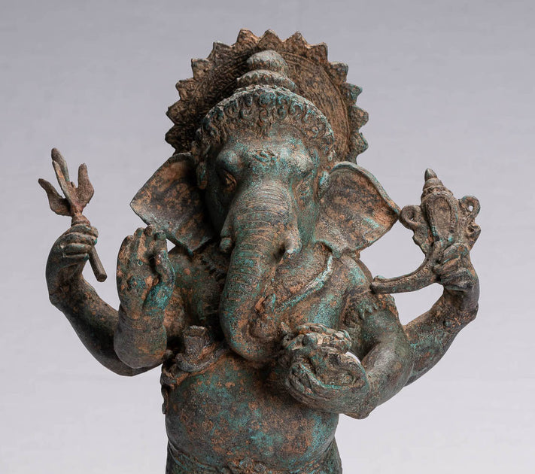
Ganesha- the remover of obstacles and the harbinger of prosperity.

Slide 9
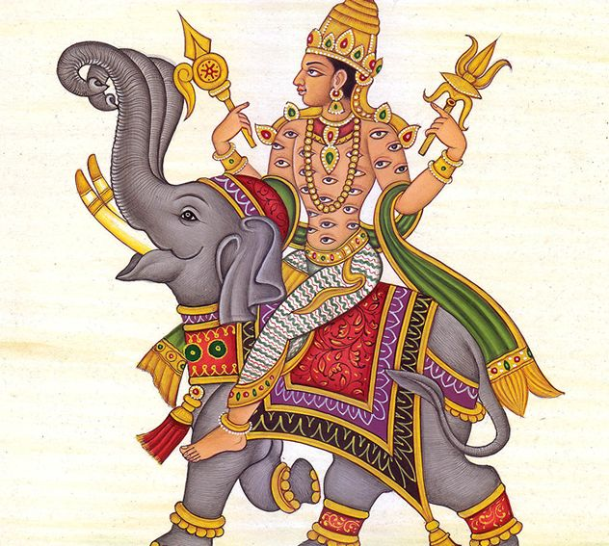
Video clip by John Greene– Crash Course India 1:00-5:00
Focus: How did the Vedic tradition transform Indian culture?
Discussion:
After watching the clip, what distinguishes Hinduism from other world religions?
“It is better to perform your own dharma poorly than another's well.”
How can Hinduism be connected to the Code of Hammurabi?

Slide 10
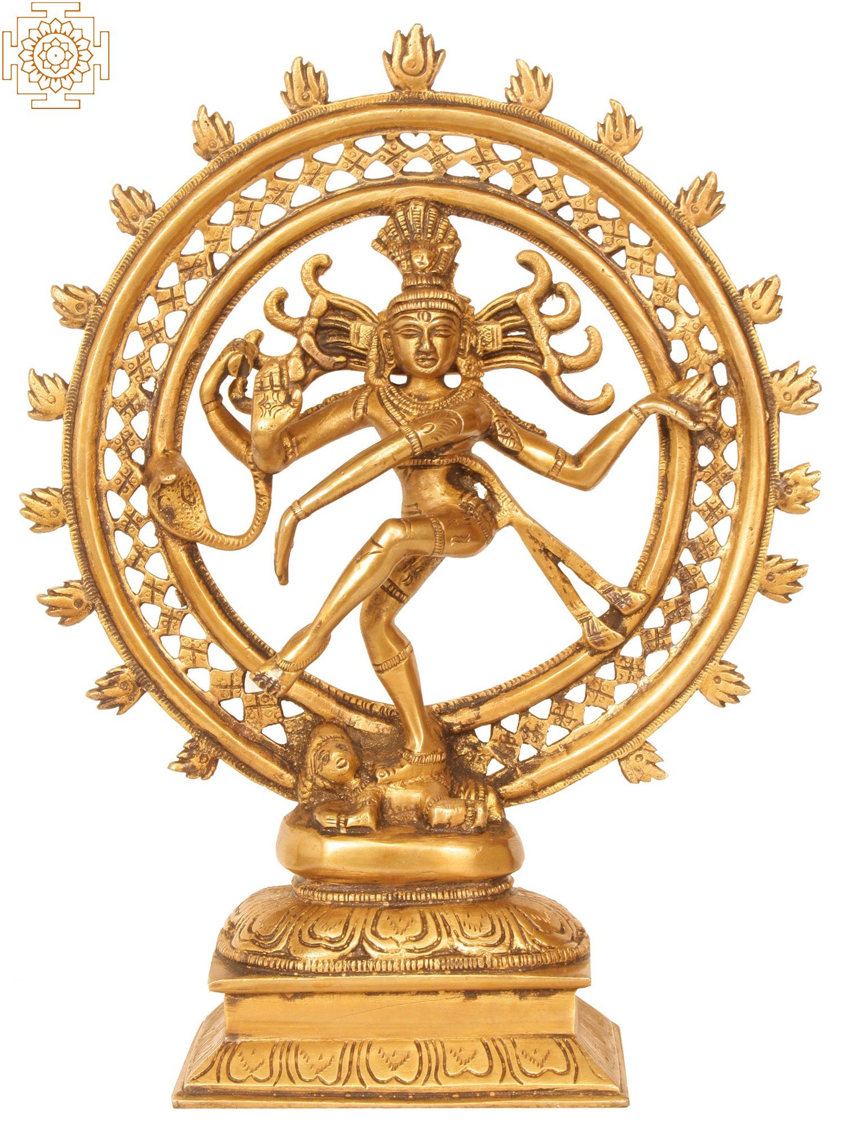
Guiding Question: Why were people in India willing to accept the caste system?
Brahman: ONE unifying spirit
Reincarnation: the rebirth of the soul- SAMSARA
Individual souls ATMAN are immortal.
The ultimate-goal of the individual soul is moksha or release from reincarnation.
Karma: the deeds in a person’s life that affect their existence in the next
Dharma: the moral and religious duties that are expected of an individual
Nataraja-
Shiva depicted as the cosmic dancer.

Slide 11
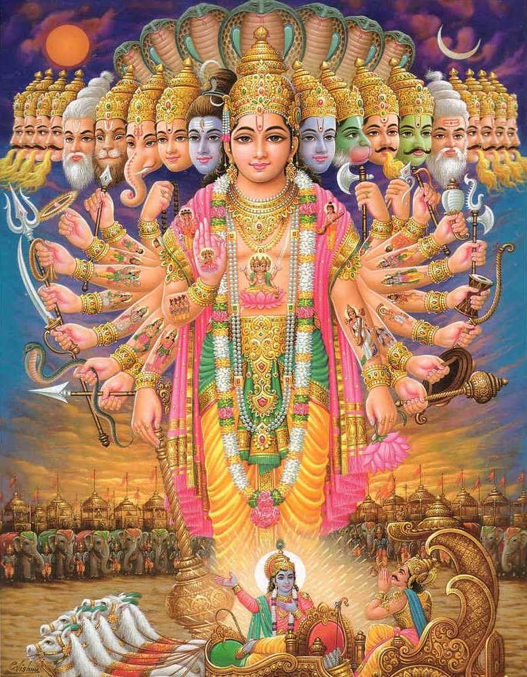
Holy Text
Focus: How did the Vedic tradition transform Indian culture?
Rig Vedas (1500 BCE) - spiritual texts that give insight to religion & Aryan Caste system.
Upanishads (800-500 BCE)- were written as a dialogue between a student and a teacher to achieve liberation from desires and suffering.
Mahabharata (400 BCE)- Ancient Indian Sanskrit epic poem regarding war and contains the Bhagavad Gita.

Slide 12
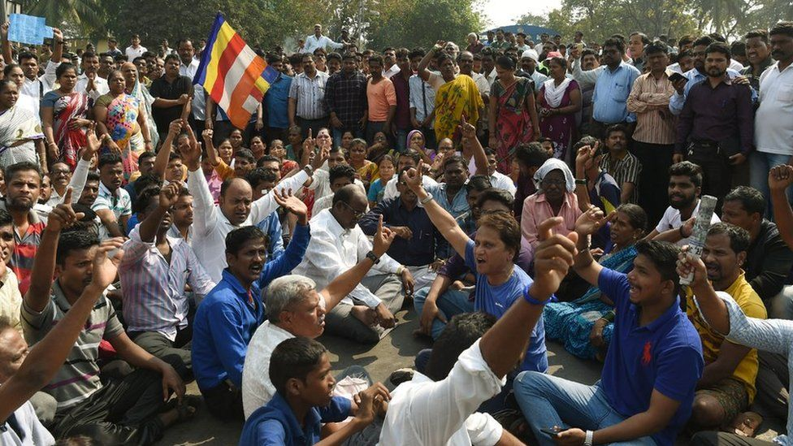
Group Activity: Read the 2007 article Bringing India's Castes to Book on the following slides.
Focus: How did the Vedic tradition transform Indian culture?
Lower caste Hindus protest after being prevented from voting.

Slide 13
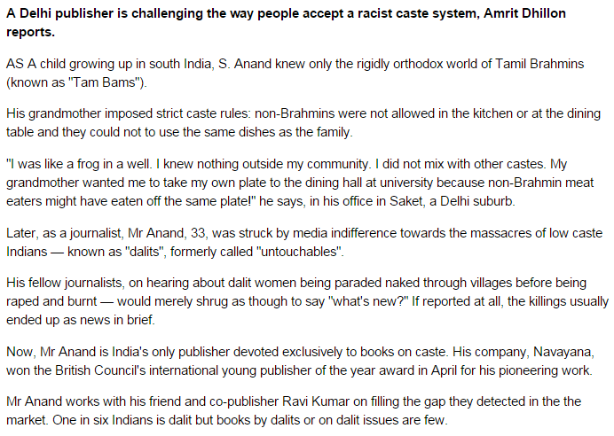
Focus: How did the Vedic tradition transform Indian culture?

Slide 14
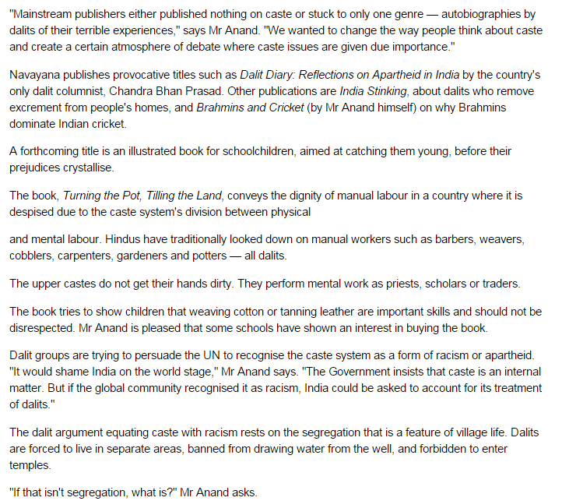

Slide 15
Homework Activity: Respond to the following question in your notebook (4-6 sentences) based on the 2010 article Bringing India's Castes to Book.
Focus: How did the Vedic tradition transform Indian culture?
Does the Caste System still exist in India? Explain.
Research: Outside of this article find another current event which illustrates one more way the Caste System still impacts modern Indian society.

